Slide 1
Welcome to Carmel-Bootcamp
Android

Slide 2
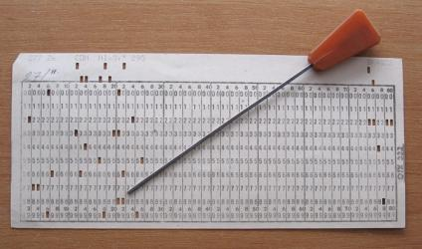
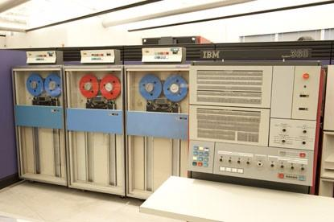
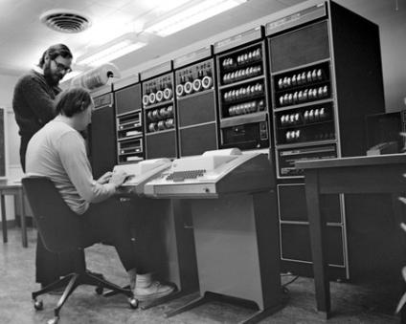
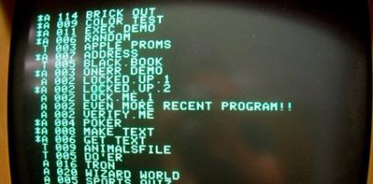
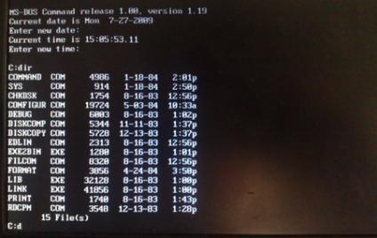
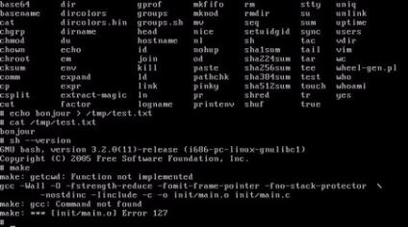
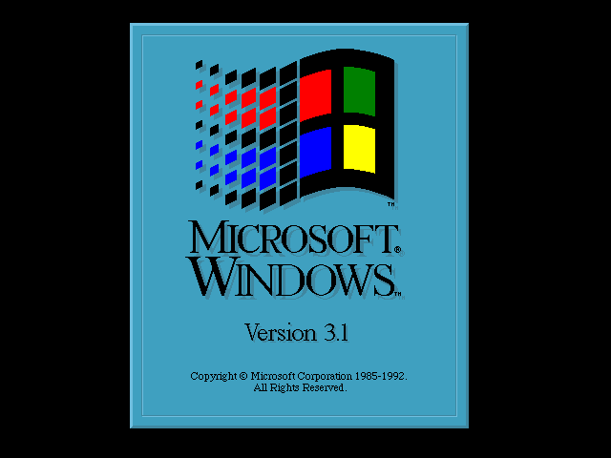
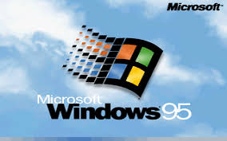
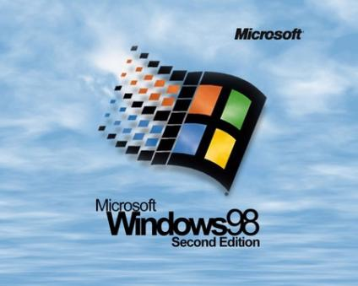
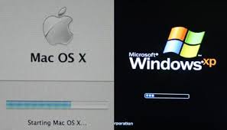
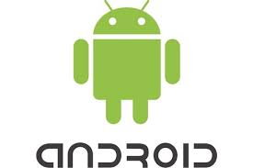

What is Android ?
1890 1964 1969 1978 1981 1991
Punched Paper Card First OS for UNIX Apple DOS MS-DOS First Linux version 0.01
Mainframes with no OS more computers Multi-tasking Dos for Apple II series OS for x86 based pc, Family of Open source Unix,
Manufacturer’s specific & multiuser for microcomputers main OS for IBM pc developed for PC’s & servers
1992 1995 1998 2001 2003 2007
Windows 3.1 Windows 95 Windows 98 Windows XP & Android Inc Android
Consumer Operating complete OS Web-based Interface mac OS x Introduced mainly as Based on Linux Kernel,
system, Introduced Introduced shortcut, Introduced Active windows XP- Plug & Play Touch screens in Digital Touch screen for smartphones,
enhancements in MS-DOS Icons & recycle bin Desktop,Windows Media for wireless networks Cameras Tablets, etc.
Player Mac OS X-Based on UNIX OS
Second widely used desktop OS

Slide 3

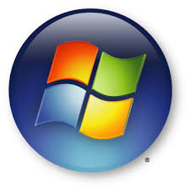


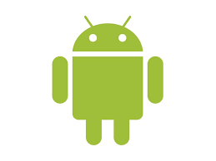
Android is an Operating System tailored for touch-based Apps

Slide 4


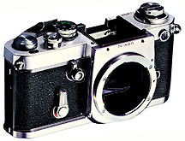


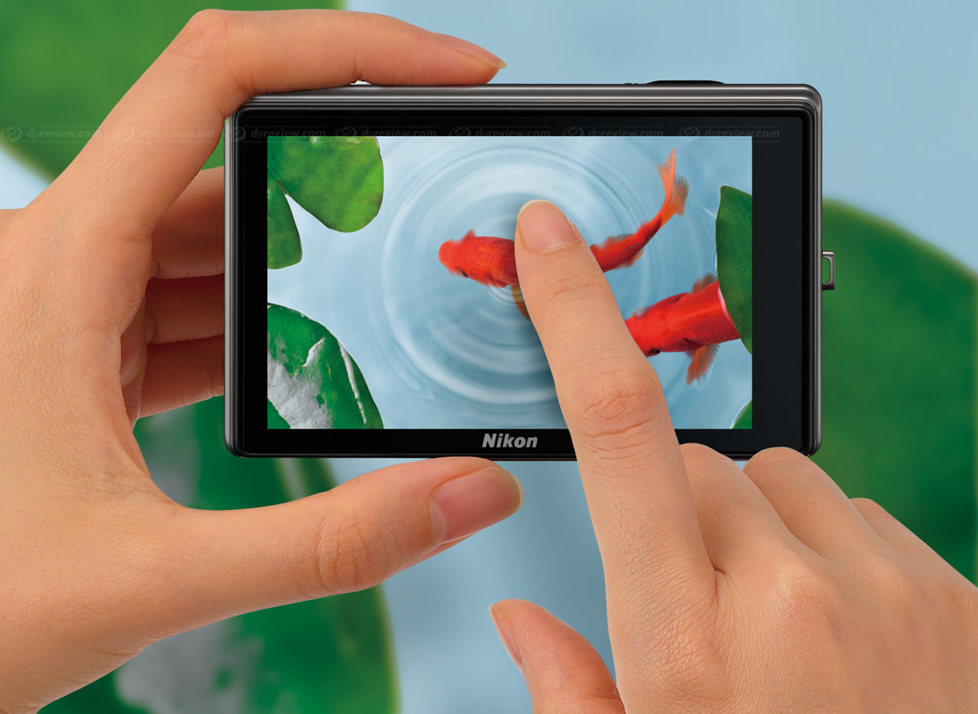
Why Android ?
Touch screen camera - a new form of input.
All peripherals in single device.
Cell phones grabbed the market.

Slide 5
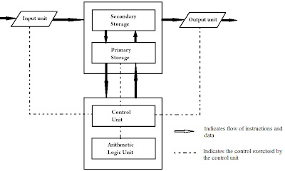
About Operating system
Basics Of OS:

Slide 6
Role of Operating system:
Memory Management
Processor Management
Device Management
File Management
Security
Control over system performance
Job accounting
Error detecting aids
Coordination between other software and users

Slide 7
Components of OS:
LINUX KERNEL
Display
DRIVERS
Flash Memory
Power Management
Camera
Keypad
WiFi
Binder(IPC)
Audio

Slide 8
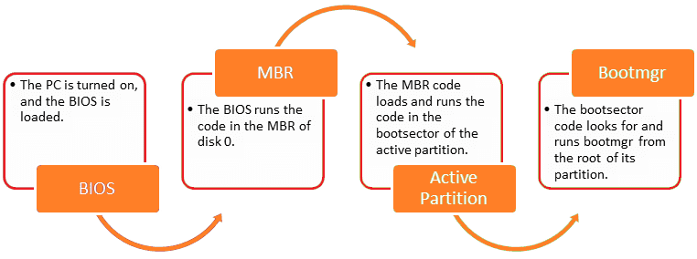
How Conventional OS works?

Slide 9
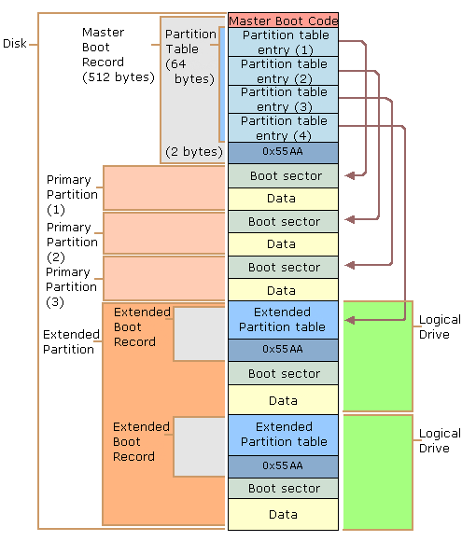
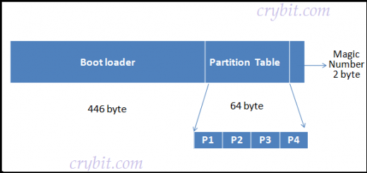
512 Bytes MBR

Slide 10
How Android works?
How Does Android Boot Up?
Cycle of the bootup process in Android
Services
1
On click
Service manager
System server
Home
Your.app
Mainactivity
2
4
daemons
runtime
Dalvik VM
Dalvik VM
Dalvik VM
3
Init
Zygote
Linux Kernel

Slide 11
ARCHITECTURE
System Apps
Java API Framework
Native C/C++ Libraries
Android Runtime
Hardware Abstraction Layer(HAL)
LINUX KERNEL
Drivers
Power Management

Slide 12
SDK
Infrastructure of all libraries which are precoded.
It is a set of development tools.
All Development happens upon SDK
Java, Kotlin, C++
Access the unique features of OS

Slide 13
TOOLS
Android Studio: Official IDE to develop an Android app
SDK tools
Gradle
apkbuilder- creates .apk packages
dx- convert .jar to.dex
adb- debug bridge
ddms- Dalvik debug monitor
traceview-views app’s execution logs
logcat- view system logs

Slide 14
USER INTERFACE - Layouts
Layout defines the visual structure of an Android UI.
Types:
Linear Layouts:
All children aligned in a single direction horizontally/vertically

Slide 15
Relative layouts:
Specify location relative to the parent/child
Constraint Layout:
Advanced version of Relative layout with
specific location
A
B

Slide 16
Frame Layout:
View 1
Holds a single child view.
For multiple child views, apply gravity attribute to each child.
View 2
View 3

Slide 17
Table Layout:
Has group of views in rows and columns
Absolute Layout:
Lets you specify the exact location
of the child with its x/y coordinates
(5,2)
(20,20)
(15,30)

Slide 18
VIEWS
What is a View ?
Basic building block for user interface components.
It is a small rectangular box which responds to the user inputs
Responsible for drawing and event handling.
Base class for Widgets.

Slide 19
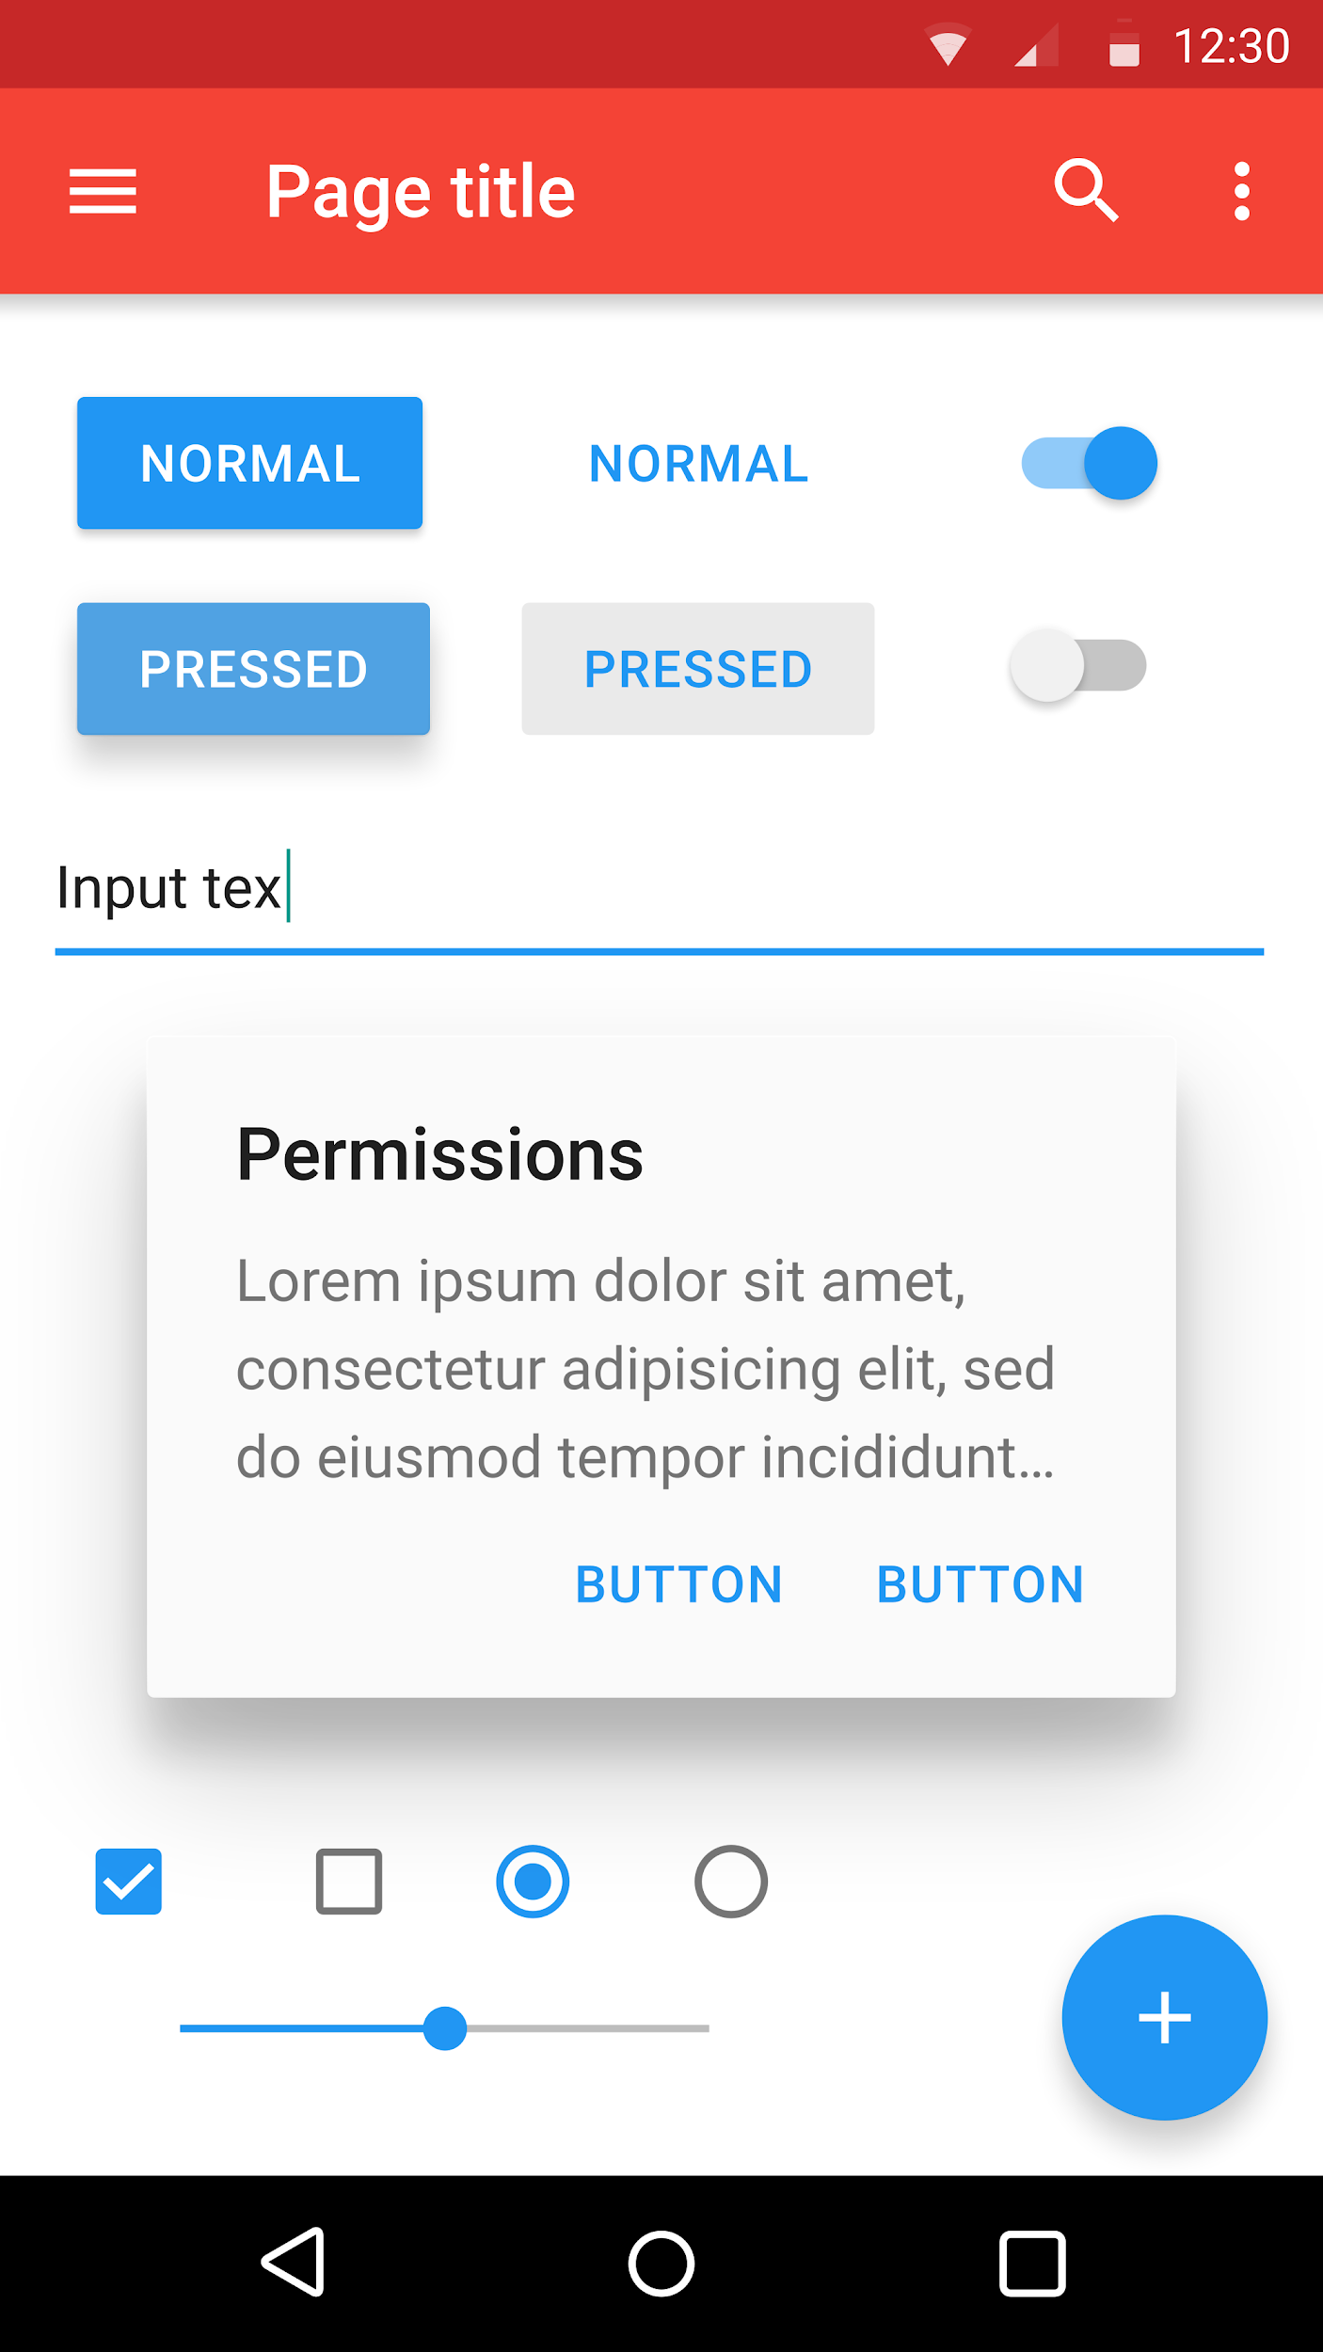
Why Views are used?
To create interactive UI components
(buttons, text fields, etc.).
Types
Text View
Toggle Button
Button
Text View
EditText
Button
ImageView
ImageButton
CheckBox
Radio button
RadioGroup
ListView
Spinner
AutoCompleteTextView
Edit Text
Check Box
Radio Button
Seek Bar

Slide 20
TextView : A User interface element that displays text to the user.
EditText: A user interface element for entering and modifying text.
Note: To define the edit text widget, specify “R.styleable.TextView_inputType” attribute.
Dropdown(Spinner): A view that allows to select an item from the dropdown menu.

Slide 21
Date View: Provides a widget for selecting a date.
List Item : It a view which groups several items and displays them in a vertical scrollable
list.
Scroll View : A view group that allows the view hierarchy placed within it to be scrolled. Scroll view may have only one direct child placed within it.
Some of the attributes are : : android:clickable
android:focusable

Slide 22
Recycler View : Android RecyclerView is more advanced version of ListView with
improved performance and other benefits.
Using RecyclerView and CardView together, both lists and grids can be created very easily

Slide 23
ViewGroup
What is a ViewGroup ?
A special view which holds other views(Children) and ViewGroup objects
It is a base class for layouts
Eg: LinearLayout is the ViewGroup that contains Button(View) and other layouts too

Slide 24
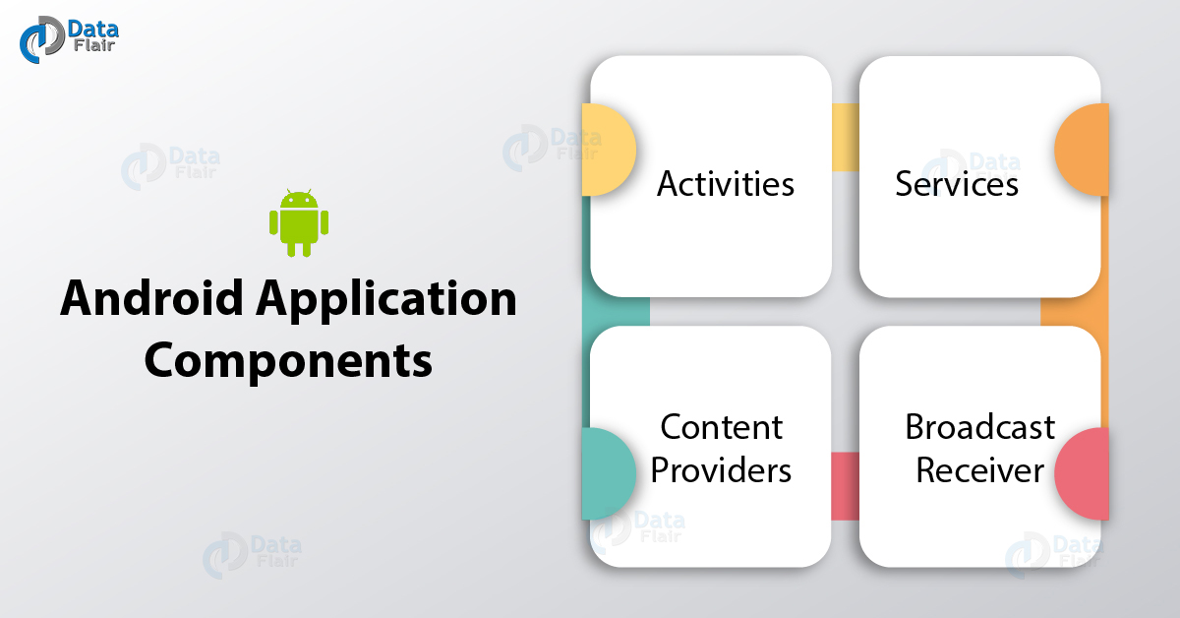
COMPONENTS OF ANDROID APPLICATION

Slide 25
1. Activity
Provides User Interface(UI)
One Activity = One Screen on the phone
Entry point for an app's interaction with the user
Can contain one or more Views
Can contain one or more Fragments
Extends the Activity Base Class

Slide 26
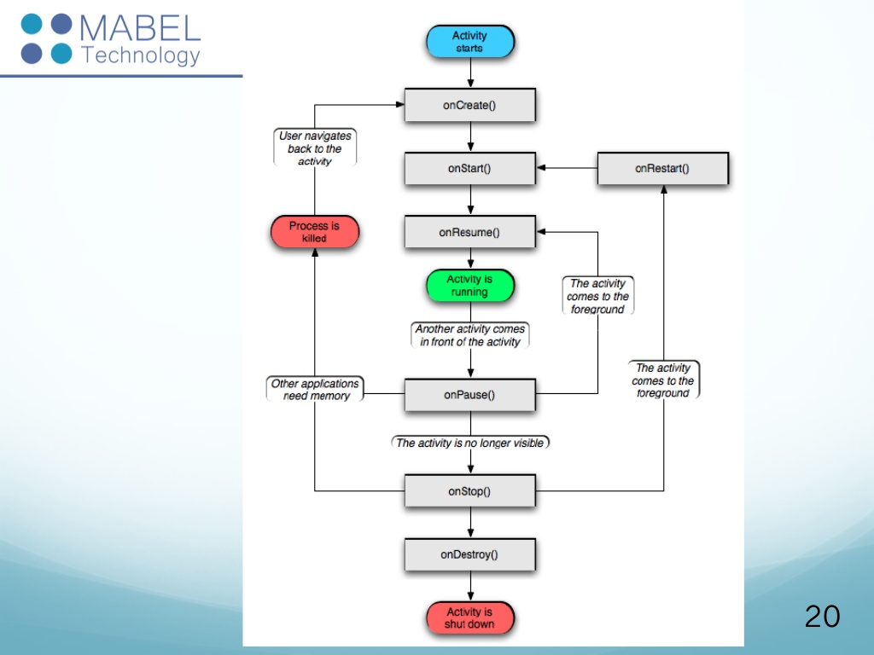
Activity- Life Cycle Four States Active/running Visible Stopped/hidden Destroyed Three key loops Entire lifetime (onCreate() to onDestroy() ) Visible lifetime (onStart() to onStop() ) Foreground lifetime (onPause() to onResume())

Slide 27
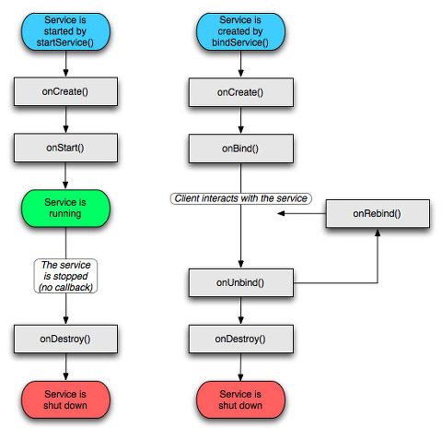
No User Interface(UI); Not bound to activity lifecycle. Runs in the main thread of app and in Background unless stopped Used for Repetitive, long running operations w/o user interaction. Extends the Activity Base Class Types: 1.Started Services 2.Bound Services
2. Services

Slide 28
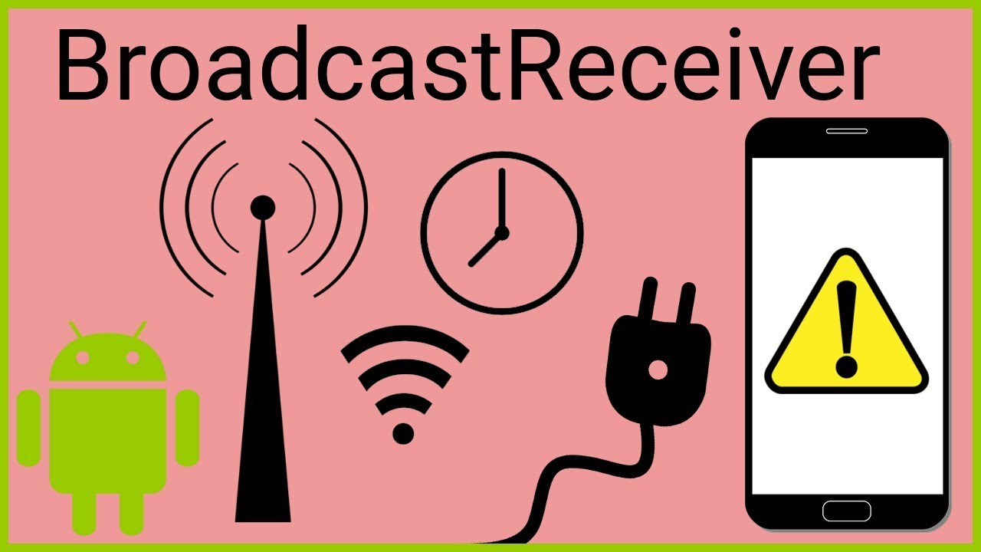
3. Broadcast Receiver
Receives and Reacts to broadcast Intents
No UI but can start an Activity
Extends the BroadcastReceiver Base Class

Slide 29
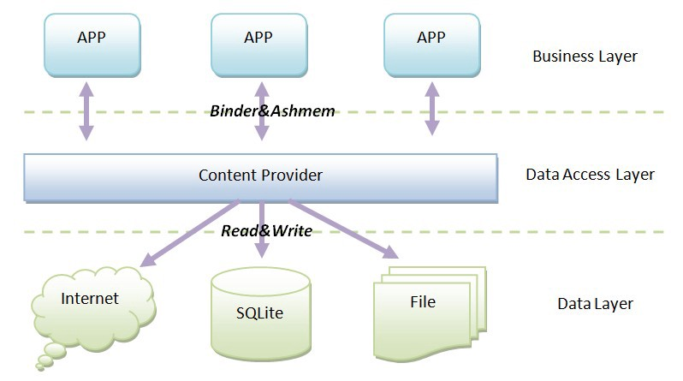
4. Content Provider
Central Repository to store app data(SQlite DB/File/N/w)
Share data with app when required.
Client/Server arrangement for data transfer/sharing.
Supports CRUD operations (Create, Read,Update, Delete)
Accessed Via ContentResolver object
Extends ContentProvider Base class

Slide 32
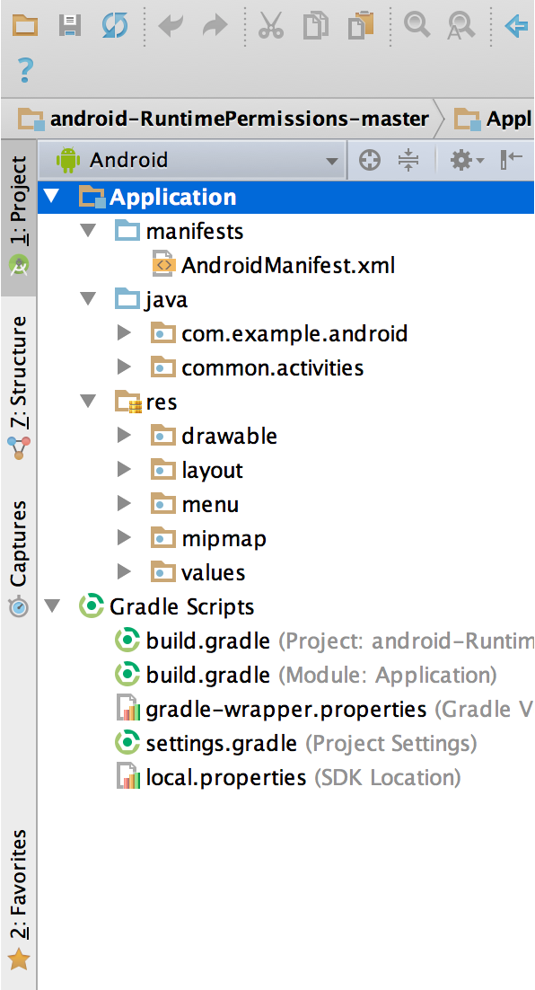
Ingredients of Android Studio
Resource:
Additional files and static content that is used by the code like drawable pictures, strings, layout definitions, animation instructions.

Slide 33
Resource Types
Animation resources
Property Animation
View Animation
Tween animation
Frame animation
Color State List Resource
Drawable resources
Layout Resources
String Resources
Style Resources
Font Resources

Slide 34
2) Java
Contains the .java source files of the project.
By default, it includes an MainActivity.java source file having an activity class that runs when the app is launched using the app icon.

Slide 35
3) Manifest File

